Slide 1
AYAN DEEP HAZRA NLP GROUP 03/09/2021

Slide 2
Summary of Work
Date | Hours Worked | Description
03/7/2021 | 3 | Elsevier, RSC
03/9/2021 | 3 | Paper

Slide 3
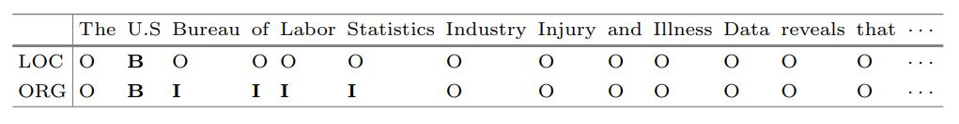
1) SciNER: Extracting Named Entities from Scientific Literature
Summary: SciNER is a generalizable Neural Network Model, for recognizing scientific entities in free text. Based on bidirectional LSTM networks, the model combines word embeddings, sub word embeddings, and external knowledge (from DBpedia) to boost its accuracy. SciNER specifically focuses on addressing challenges associated with the rare words and terminologies used in scientific texts.
Process: Uses LSTM (Long-Short Term Memory) network which operates similar to how human minds work. LSTMs can retain knowledge of previous tokens and therefore predict words that come up later in a sentence. When using beginning-inside-outside (BIO) labelling , a label “B,” “I,” or “O” is assigned to each token in the training corpus.

Slide 4
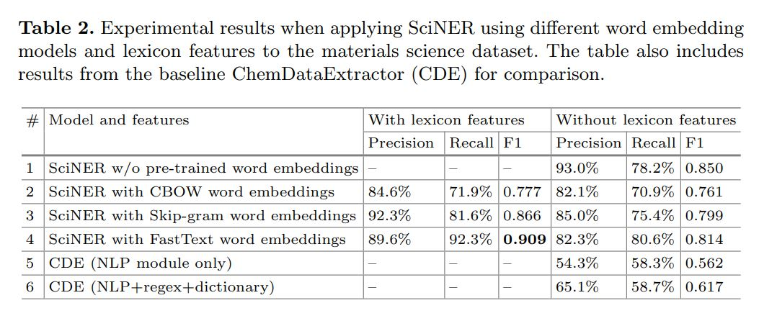
SciNER vs CDE

Slide 5
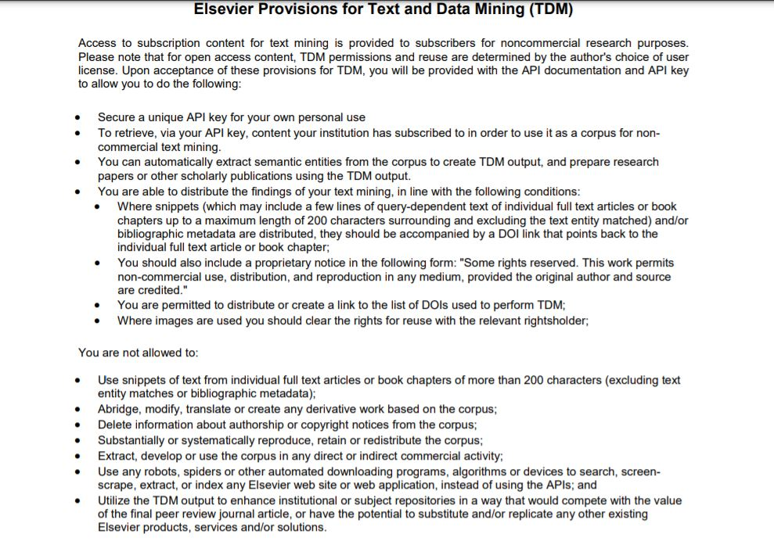

Slide 6
Royal Society of Chemistry
RSC themselves make it a condition of publication that authors allow the usage of their papers, even for large scale data mining processes, granted apt credit is given to the authors.
Data available as XML and images.
Fields covered include Chemical analysis, Polymers, Battery and electrochemistry and more.
Depending on their local legal framework, researchers in academia may be permitted to carry out TDM on articles accessed via our article pages for non-commercial uses, and should check with their institution’s librarian.

Slide 7
Next Steps
Try to use CDE to extract data from these websites (Elsevier, RSC).
Look in depth as how to SciNER works and if it is a viable alternative.

Slide 8
Sources
Elsevier tdm: https://www.elsevier.com/open-science/research-data/text-and-data-mining
RSC tdm: https://royalsociety.org/journals/ethics-policies/data-sharing-mining/
RSC tdm: https://www.rsc.org/journals-books-databases/research-tools/text-and-data-mining/
Elsevier tdm: https://www.elsevier.com/__data/assets/pdf_file/0012/102234/TDM-sign-up-short-form.pdf
SciNER: https://link.springer.com/content/pdf/10.1007%2F978-3-030-50417-5_23.pdf

